Slide 1
Diabetes Detection System
Shankar Gurjar, Kshitij Upasani

Slide 2
The Dataset
Data provided by National Institute of Diabetes and Digestive and Kidney Diseases.
Tracks Pregnancies, Glucose, BloodPressure, SkinThickness, Insulin, BMI, DiabetesPedigreeFunction and Age.
Replaced all rows with NA or 0 with Median. We also tried Mean but distribution was right skewed so found median more useful approach for our use case.

Slide 3
The Variables & Definations
Pregnancies- “The condition or period of being pregnant”
Glucose - “type of sugar in the blood and is the major source of energy for the body's cells.”
BloodPressure - “The force of blood pushing against the walls of your arteries as your heart pumps blood through your body.”
SkinThickness - “Thick skin is thicker due to it containing an extra layer in the epidermis, called the stratum lucidum”
Insulin - “A hormone produced in the pancreas by the islets of Langerhans, which regulates the amount of glucose in the blood. The lack of insulin causes a form of diabetes.”
BMI - “Body mass index (BMI) is a ratio of a person's weight in kilograms to the square of their height in meters.”
DiabetesPedigreeFunction- “The 'DiabetesPedigreeFunction' is a function that scores the probability of diabetes based on family history, with a realistic range of 0.08 to 2.42”
Age - “The length of time that a person has lived”
Outcome - “Diabetes, Yes or No”

Slide 4
Our Interest
1. Diabetes detection in early stages to provide better treatment plans to patients.
2. Explore the connection between other variables and diabetes.
3. Make informed decisions about diabetes using ML and help community to live better healthy life.

Slide 5
Exploratory data analysis(EDA)

Slide 6
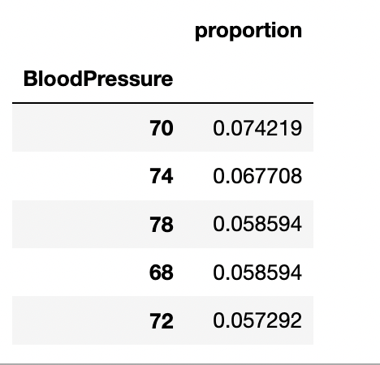
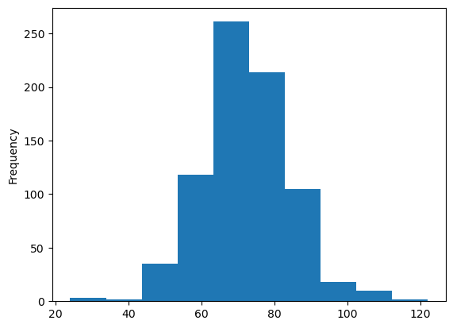
BloodPressure Variable
First we checked the distribution of data. data is normally distributed. also used value count function to see the proportion. of values.

Slide 7
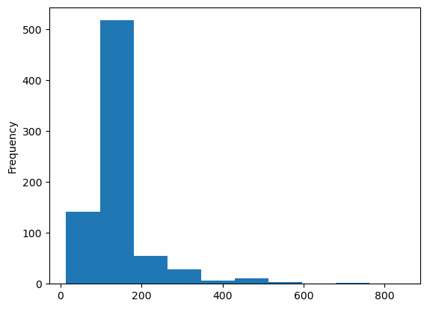
Insulin Variable
Insulin variable distribution was right skewed upon checking found that there were a lot of 0 values. To make data normally disturbed used median method and replaced 0 with median of non zero values.

Slide 8
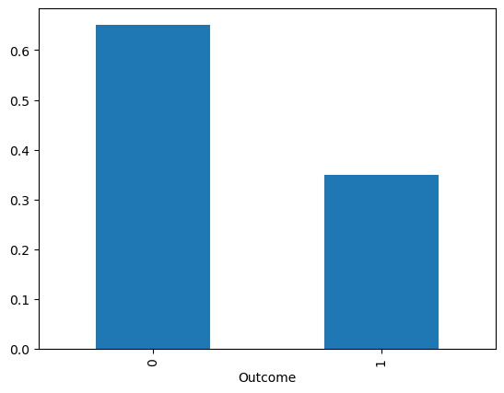
Output variable
Explored the output variable and seems data is balanced where 65% values are o(no diabetes) and 35% values are 1(yes diabetes).

Slide 9
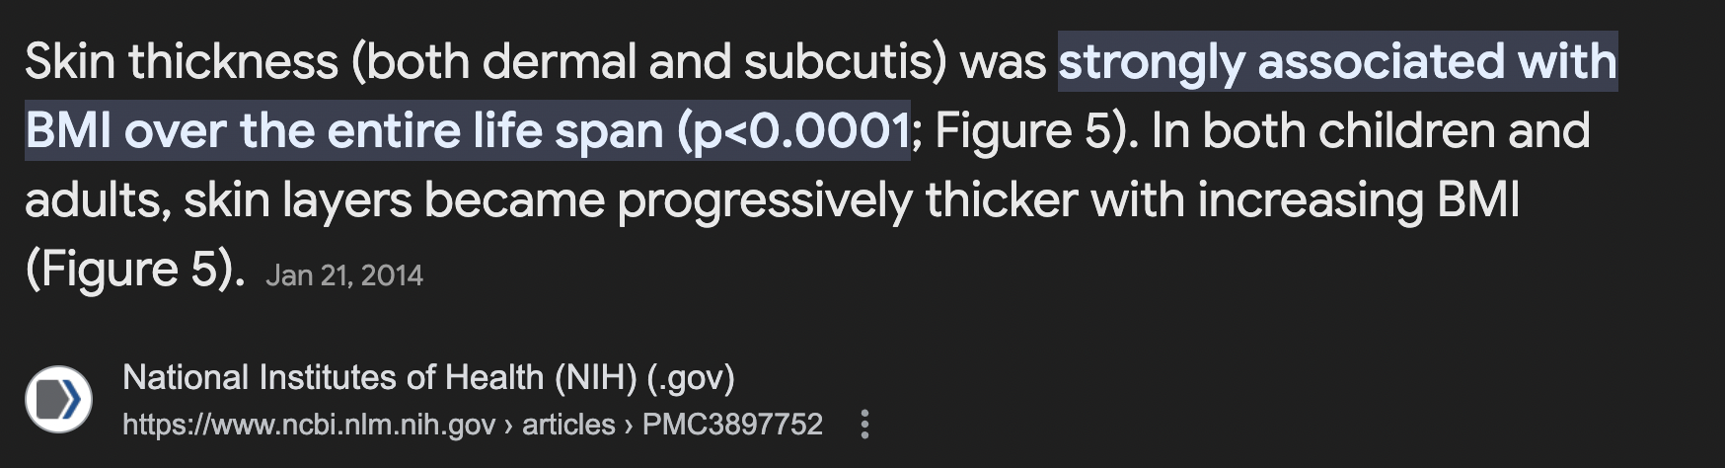
Correlation Matrix
Upon reviewing correlation matrix did not find any strong correlation between variables but there are some variables that shows some natural mild correlation listed below.
pregnancies and age correlation value is 0.54.
Skinthickness and BMI correlation value is 0.54.
Glucose & outcome correlation value is 0.49.

Slide 10
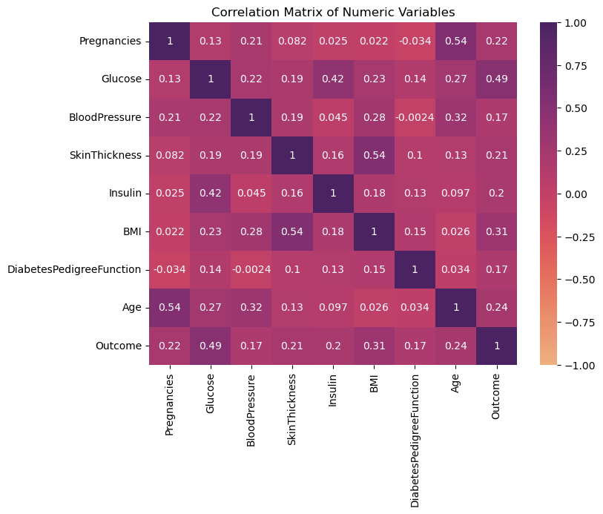
Correlation Matrix

Slide 11
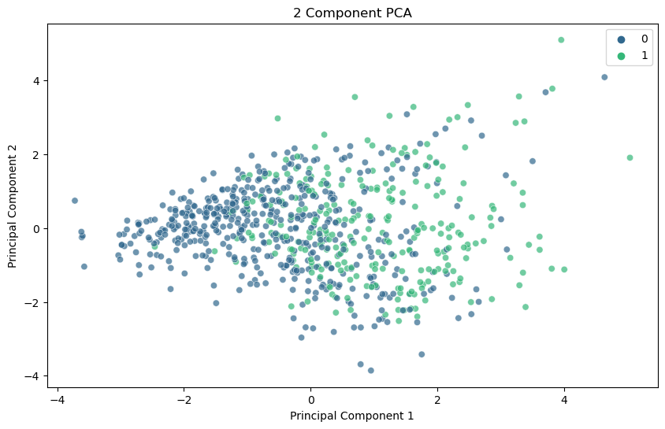
PCA

Slide 12
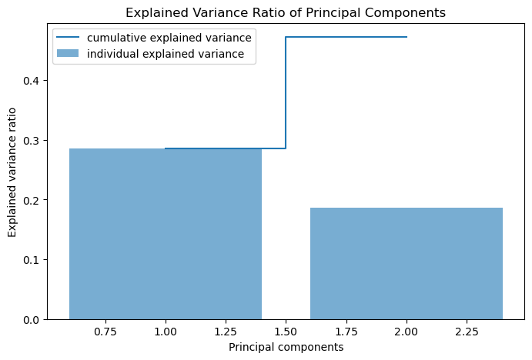
EVR

Slide 13
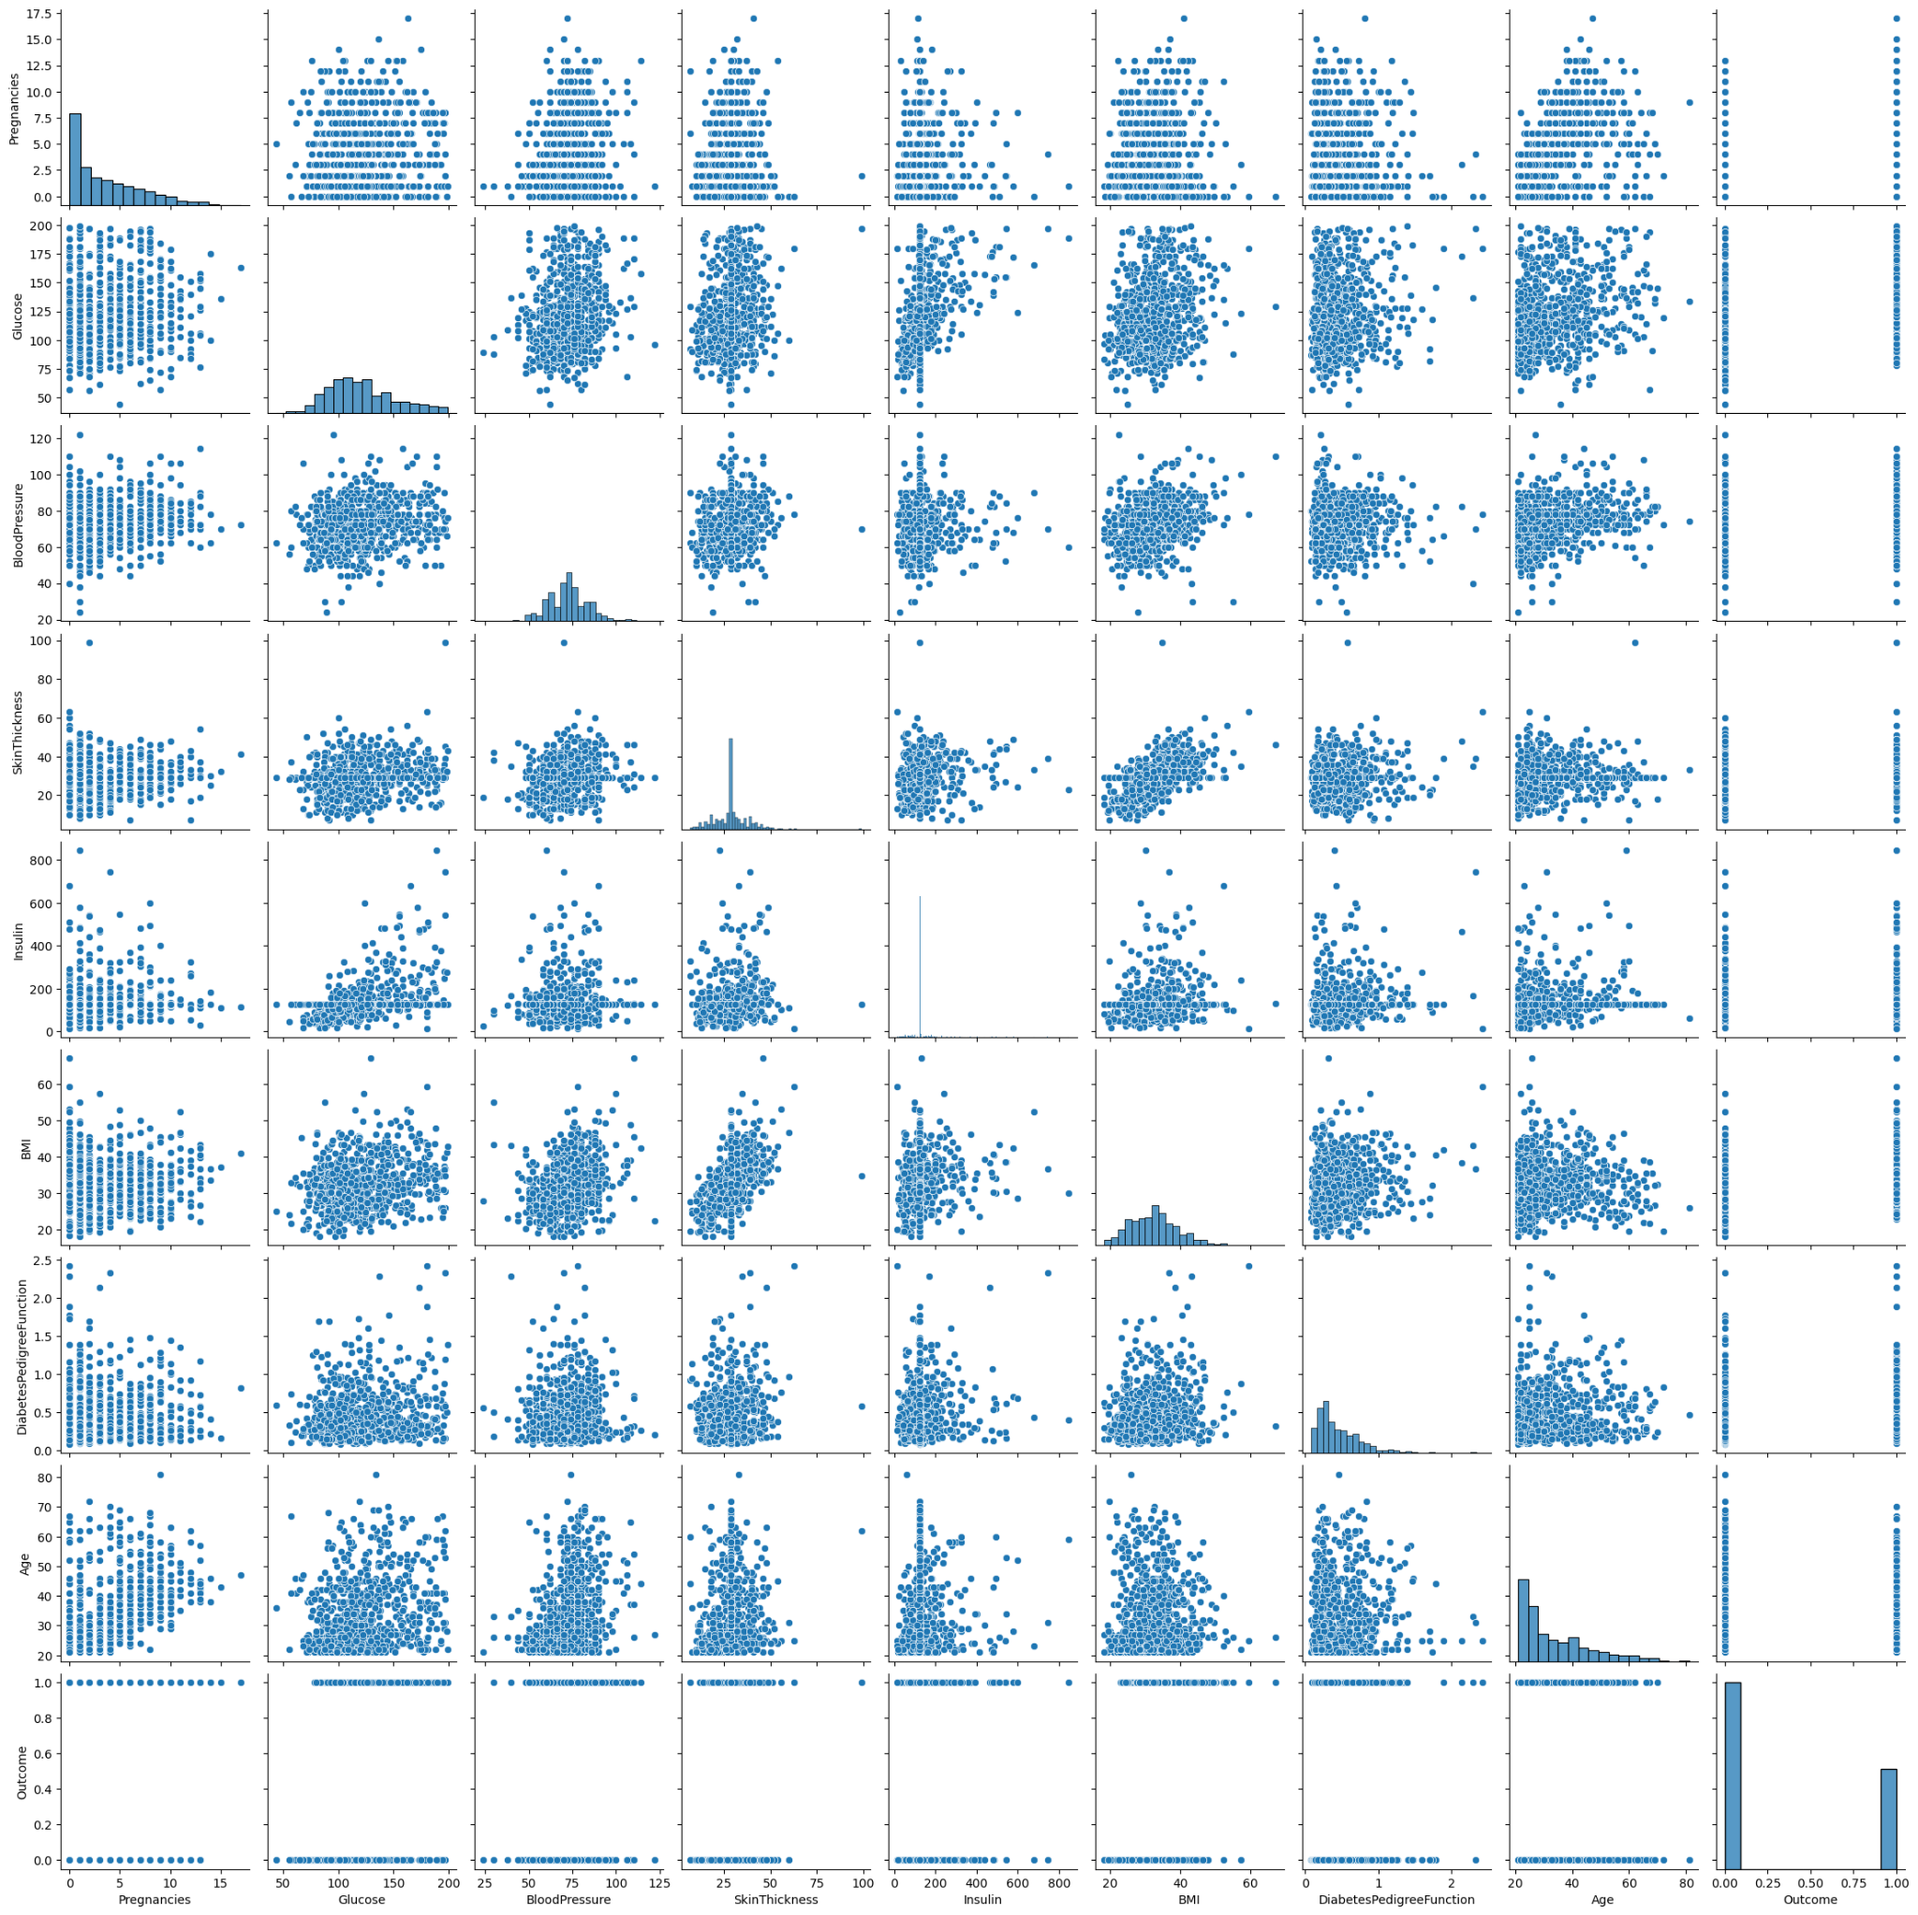
Pair scatter plot

Slide 14
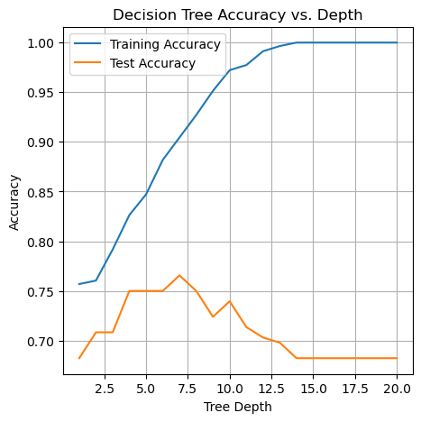
Decision Tree
Implemented decision tree algorithm to predict the diabetes.
Built with entropy as splitting method
Highest Accuracy (77%) achieved
with tree depth 7.
Actual values
Confusion Matrix | Positive | Negative
Positive | 105 | 20
Negative | 25 | 42
Predicted Values

Slide 15
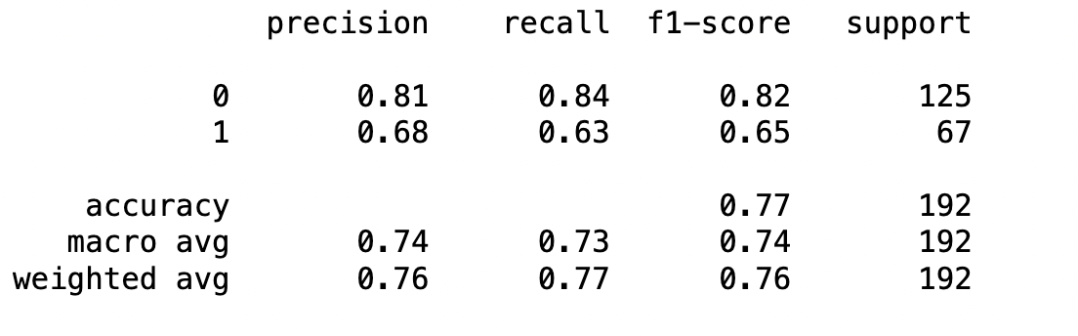
Decision tree classification report

Slide 16
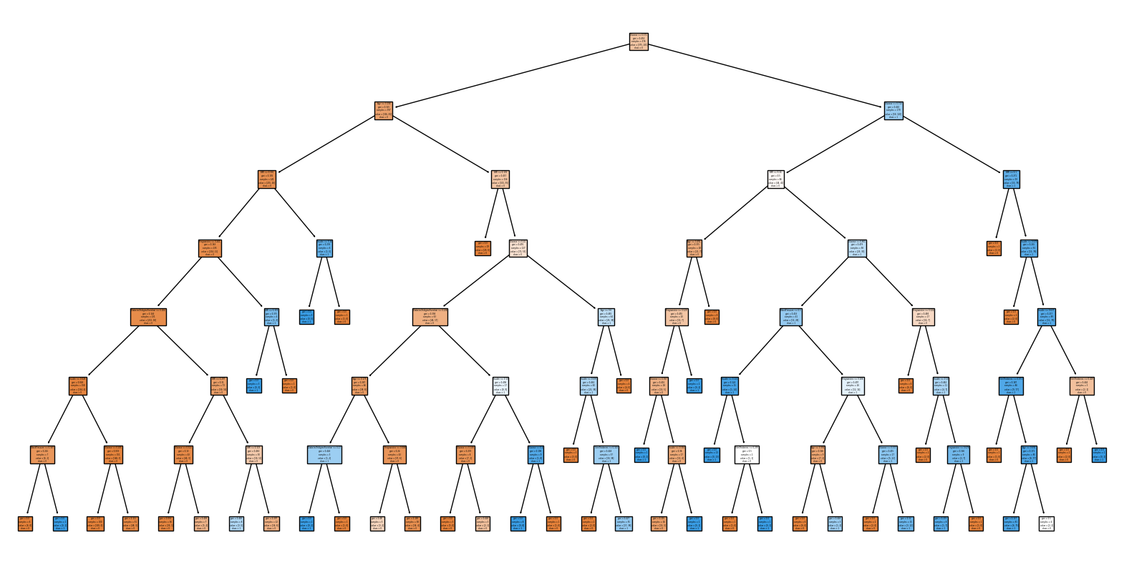
Decision Tree Example
Depth of 7
77% accuracy

Slide 17
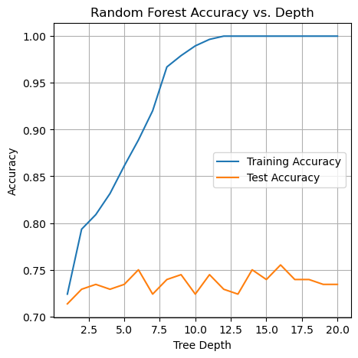
Random Forest
Best Depth is 16.
Accuracy = 76%
Training Accuracy = 100%
Actual values
Confusion Matrix | Positive | Negative
Positive | 107 | 18
Negative | 29 | 38
Predicted Values

Slide 18
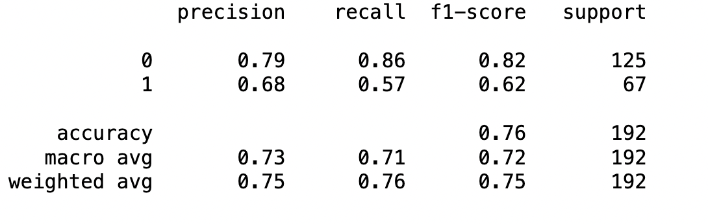
Random Forest classification report

Slide 19

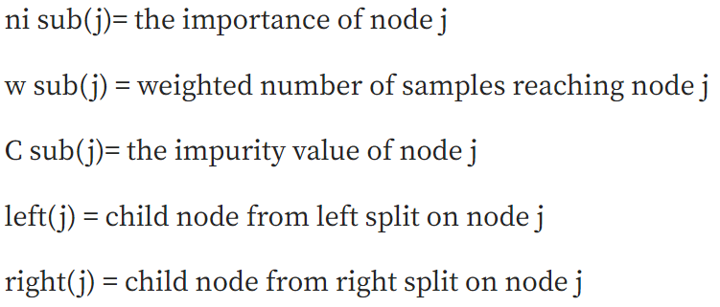
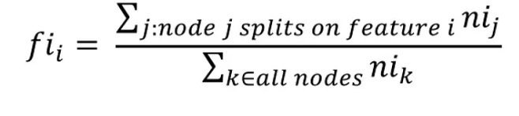
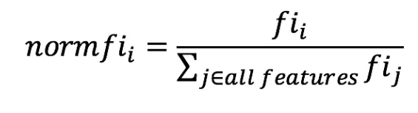
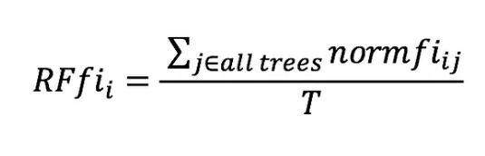
Feature Importance in Random Forest
Feature importance is calculated as the decrease in node impurity weighted by the probability of reaching that node. The node probability can be calculated by the number of samples that reach the node, divided by the total number of samples. The higher the value the more important the feature
Node impurity is ratio of both classes present at node (most pure = 1, most impure = 0.5)
https://towardsdatascience.com/the-mathematics-of-decision-trees-random-forest-and-feature-importance-in-scikit-learn-and-spark-f2861df67e3

Slide 20
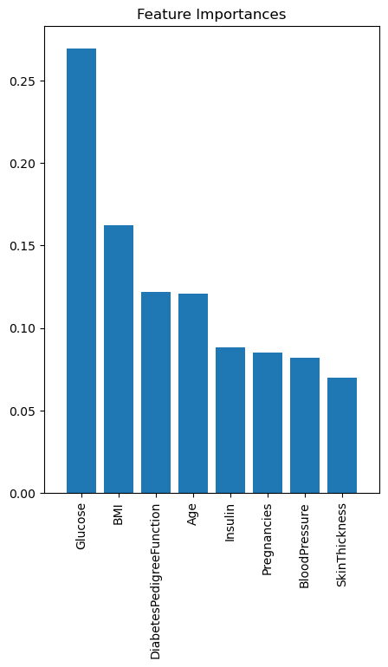
Random Forest - Feature Importance
Most important variables are
glucose
BMI
DPF
Age

Slide 21
Conclusion
Implemented 2 different ML algorithms and evaluated on test dataset. Decision tree performed better than random forest with precision weighted avg of each 76% and 75%. Selected decision tree for diabetes prediction.
Random forest feature information suggests that glucose, BMI and dpf closely tied to diabetes.
To diagnosis of diabetes in early stages patient should keep track of glucose, BMI & dpf.

Slide 22
Thank you
End Of The Report

